Slide 1

Financial Analytics
Manoel Fernando Alonso Gadi Associate Professor
manoelgadi@campusciff.net
Sesión 2 - Analítica para individuos - Crédito y Fraude
Madrid

Slide 2
Positives and negatives of scoring
√ Large volumes
X Small volumes
√ Small-Medium tickets
X Outlier tickets
√ Centralised calculated
X Network based
√ Little personal contact
X Heavy personal contact
√ Number culture
X Hierarchy culture
√ Small-Medium tickets
X Lending mystiques
√ Credit central to organisation
X Cultural factors
√ Free of prejudices

Slide 3
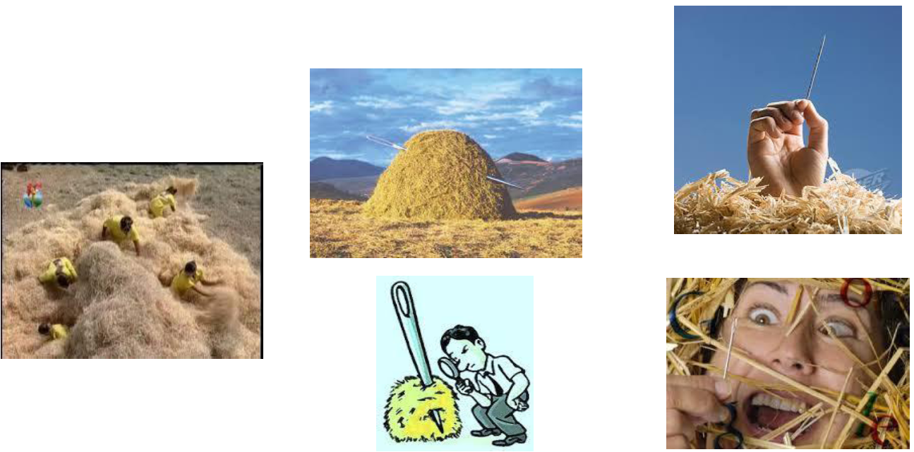
The wok of fraud detection

Slide 4
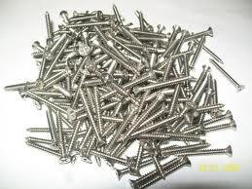
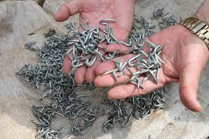
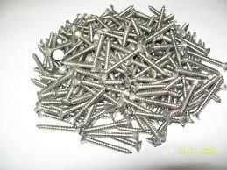
What our bosses expect

Slide 5
HYBRID APPROACH
Manual Detection
Heuristic Rules
Anomaly Detection
Predictive Models
Network Analysis
VALUE
SOPHISTICATION

Slide 6
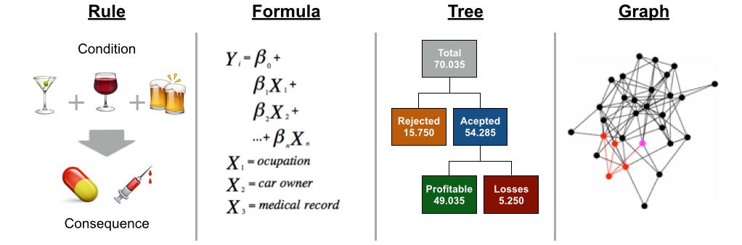
Model shapes – more outlier detection oriented,
that is dividing population in smaller groups
ps. Neural Networks also play a big role in fraud detection

Slide 7
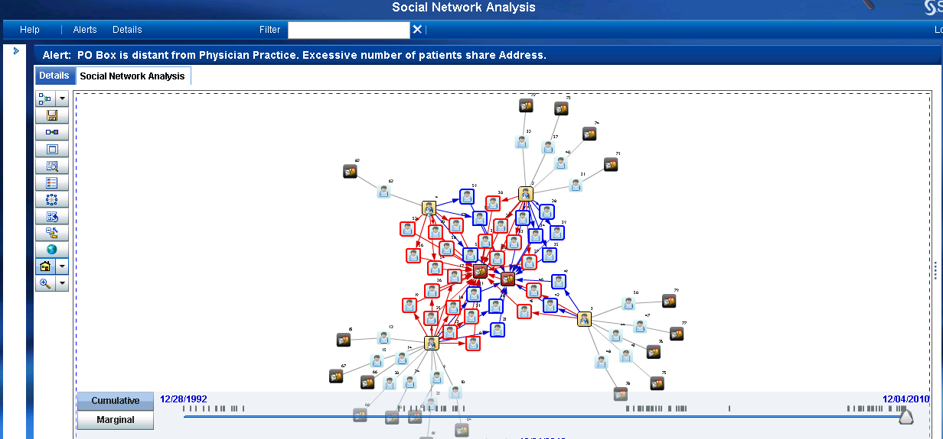
SAS and others provide Social Network Analysis
for Fraud Detection

Slide 8
The detection, confirmation and investigation
Detection (in general done by algorithms)
Business Rules
Analytics
Confirmation (in general done by humans)
Internal Analysis
Contacting Customer
Investigation (mix of algorithms/humans)
Internal
Police / Detectives

Slide 9
Counter-Fraud cycle
PREVENTION
INVESTIGATION/ RECOVERY
DETECTION
CONFIRMATION

Slide 10

Main types of fraud
Lost or Stolen
NRI – Never Received Issuance(card never arrived)
FA – Fraud Application
ATO – Account Take Over
Manual Counterfeit
Skimming
Cross Border
MOTO – Mail Order / Telephone Order (Internet).
Let’s watch some videos!

Slide 11
The cost of fraud
Tangibles
Amount lent
Cost of investigation
Operational costs – sending a new card
Operational costs – Calls to customer service
Charge backs
Cost of referred transactions (call-me)
Cards cancelations
Costs of inclusions of card number into black lists
If not a real fraud – loss in income
If not a real fraud – loss in Market Share
Intangibles for a bad fraud management
Reduction of customer satisfaction
Violation and vulnerability sentiments toward the company
Loss of competitiveness
Personal physical risk towards people involved in the business.
Loss of brand loyalty
Cost of opportunity

Slide 12
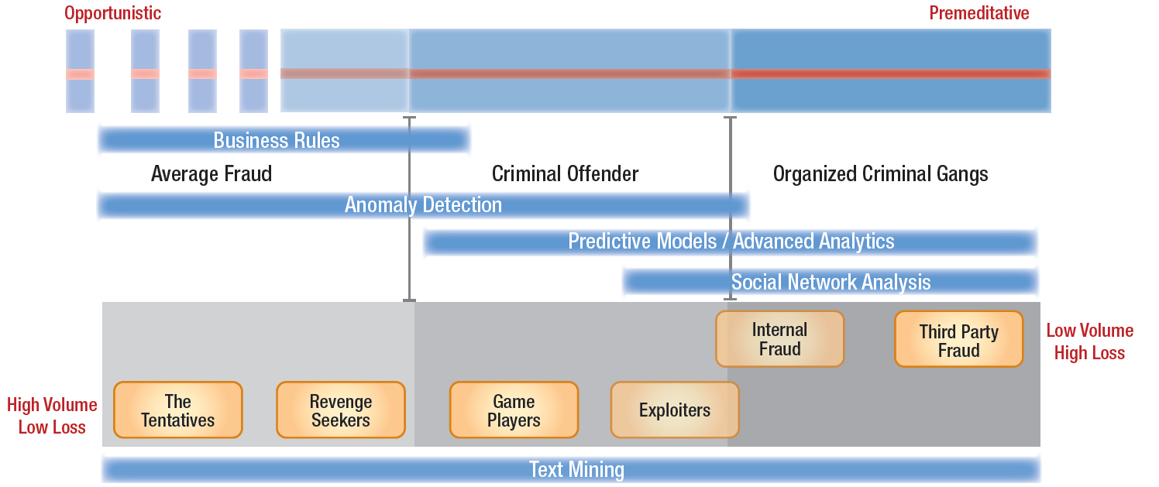

Map of fraudsters according to SAS
SOURCE:

Slide 13
We will centre out efforts in Decision Trees to understand some of fraudster behaviour
Divide the population in smaller groups is a need in fraud models in order to the chance of finding fraud (in modelling terms, to increase prediction power – higher GINI), but almost certainly this will generate over fitting and therefore the model will have a shorter life spam.
Fraud detection models have to be recalibrated every 2-6 months.
NEXT ... THE PAPER SHOWS WHY DECISION TREES ....

Slide 14
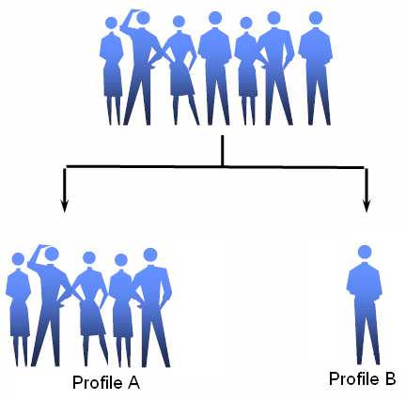

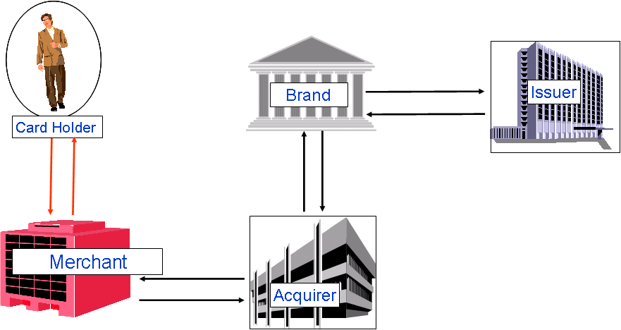

Data
Specificities of fraud data
Skewed data:
Different costs:
Classified As:
Not Fraud
Fraud
Actual
Not Fraud
TN = $ 0
FP = $ 1.00
Fraud
FN = $ 100.00
TP = $ 1.00
TP = truepositive
FP = false positive
TN = true negative
FN = false negative
Too many legitimates to one fraud.
Dimensionality:
Time to answer:
Leaving few 100s milliseconds
for fraud decisioning
Interactions make the problem exponential

Slide 15
Methods
Assessed methods and parameters optimized
Naive Bayes (NB) No parameters
Decision Tree (DT) 2 parameters
FIVE METHODS
COMPARED
21 PARAMETERS
TO BE OPTIMIZED
Bayesian Net (BN) 3 parameters
Neural Net (NN)
7 parameters
Artificial Imune System (AIS)
9 parameters

Slide 16
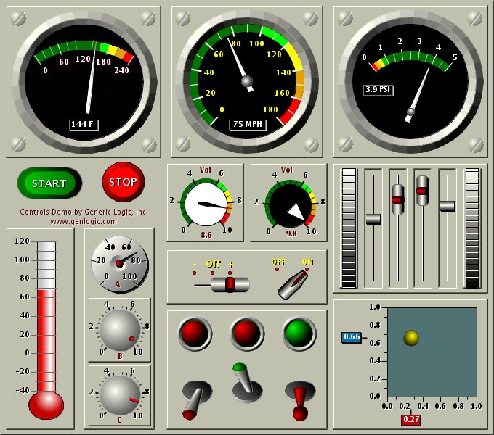
Methods
Parameter optimization
Automatically Alter Parameters
To Find Optimal Value
Minimize Fraud
Cost

Slide 17
Fraud Cost
Objective Function Definition
Question: Which function makes more difference for the shareholder?
Maximize
KS or Roc Curve
?
Widely used by academics, not easy to transform in money.
Maximize
Hit Rate and
Detection Rate
?
Widely used by the industry, but it is necessary to use both combined to properly manage fraud. It is unnecessarily harder to optimize a multinomial function in this case.
Minimize Fraud Loss Only
?
Minimize Total Fraud Cost ?
Takes into account the real cost of fraud, but does it without taking the fraud operational costs into account.
Takes into account the real cost of fraud including fraud losses + operational costs.

Slide 18
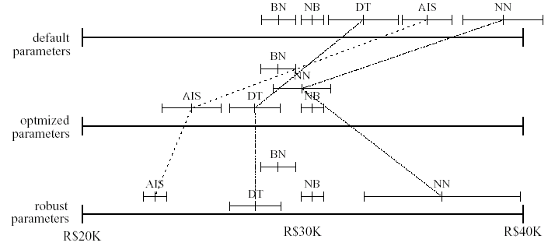
Results
Result Graph – Plain execution

Slide 19
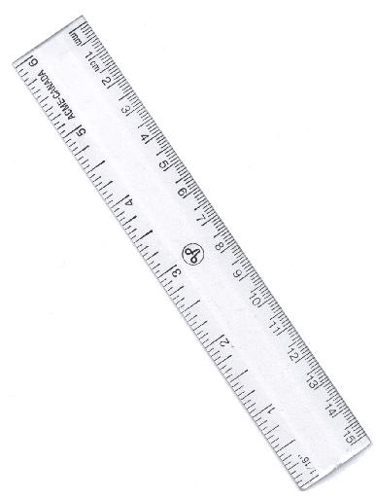
Optmizat.
Cost Sensitive Classifier
Replication
Greater Fraud Probability
Cut-off point which minimizes the cost (moves it to be 50%)
Score
Reweight
Smaller Fraud Probability
Notes:
In general, models are better to distinguish around 50% than extreme value, therefore it is better to make cut-off to be around this value.

Slide 20
Results
Results Graph – Cost Sensitive.

Slide 21

Results
Results Graph
Both DT and AIS are rule based methods, is it coincidence to be better for fraud? No, fraud is not human behaviour but humans playing around to beat the system!!! So, it can be mapped by rules.
PLAIN TRAINING
COST SENSITIVE

Slide 22
Financial Analytics
Manoel Fernando Alonso Gadi Associate Professor
manoelgadi@campusciff.net
Sesión 2 - Analítica para individuos - Crédito y Fraude
Madrid

Slide 23
Generalized Linear Model Regression Results
==============================================================================
Dep. Variable: ob_target No. Observations: 593
Model: GLM Df Residuals: 514
Model Family: Binomial Df Model: 78
Link Function: logit Scale: 1.0
Method: IRLS Log-Likelihood: -155.12
Date: Fri, 10 Oct 2014 Deviance: 310.24
Time: 17:11:43 Pearson chi2: 726.
No. Iterations: 26
==============================================================================
coef std err t P>|t| [95.0% Conf. Int.]
------------------------------------------------------------------------------
if_var_81 -0.0965 0.150 -0.643 0.520 -0.390 0.197
if_var_80 -4.19e+06 6.29e+06 -0.667 0.505 -1.65e+07 8.13e+06
ib_var_21 0.3136 0.976 0.321 0.748 -1.598 2.226
ib_var_20 0.0080 1.454 0.006 0.996 -2.842 2.858
ico_var_51 0.3043 0.215 1.413 0.158 -0.118 0.727
ico_var_50 0.2798 0.332 0.843 0.399 -0.371 0.931
ico_var_53 -0.7005 0.307 -2.282 0.022 -1.302 -0.099
ico_var_52 0.2085 0.206 1.014 0.310 -0.194 0.611
ico_var_55 -0.2220 0.305 -0.727 0.467 -0.820 0.376
ico_var_54 -0.2241 0.218 -1.027 0.304 -0.652 0.204
ico_var_57 0.0680 0.221 0.308 0.758 -0.365 0.501
ico_var_56 0.5072 0.250 2.032 0.042 0.018 0.996
ico_var_59 0.0630 0.268 0.235 0.814 -0.463 0.589
ico_var_58 -0.0561 0.244 -0.230 0.818 -0.535 0.423
ico_var_25 0.2703 0.341 0.792 0.428 -0.399 0.939
ico_var_26 0.3858 0.356 1.083 0.279 -0.313 1.084
ico_var_27 0.9745 0.371 2.627 0.009 0.247 1.702
ico_var_28 0.1577 0.331 0.476 0.634 -0.492 0.807
ico_var_29 -0.6224 0.324 -1.921 0.055 -1.257 0.013
ico_var_64 0.1559 0.324 0.481 0.631 -0.480 0.791
if_var_65 -0.0057 0.025 -0.232 0.816 -0.054 0.043
ico_var_60 0.2065 0.268 0.772 0.440 -0.318 0.731
ico_var_61 -0.1859 0.301 -0.617 0.537 -0.776 0.404
ico_var_62 -0.2433 0.204 -1.191 0.234 -0.644 0.157
ico_var_63 0.0180 0.226 0.080 0.937 -0.424 0.460
ib_var_6 0.0857 0.385 0.222 0.824 -0.670 0.841
ib_var_7 1.5941 1.246 1.279 0.201 -0.848 4.037
ib_var_4 -0.0688 0.466 -0.148 0.883 -0.982 0.844
ib_var_9 -0.0006 0.001 -0.800 0.424 -0.002 0.001
ib_var_2 -0.0068 0.503 -0.013 0.989 -0.993 0.979
if_var_67 -0.0180 0.034 -0.534 0.593 -0.084 0.048
ib_var_1 -0.9487 1.061 -0.894 0.371 -3.029 1.132
if_var_66 0.3556 5215.921 6.82e-05 1.000 -1.02e+04 1.02e+04
icn_var_23 -0.1955 0.181 -1.077 0.281 -0.551 0.160
icn_var_22 -0.2774 0.277 -1.002 0.316 -0.820 0.265
ib_var_8 25.6578 1.3e+05 0.000 1.000 -2.55e+05 2.55e+05
icn_var_24 0.3971 0.262 1.516 0.130 -0.116 0.911
ib_var_5 -2.0353 0.894 -2.276 0.023 -3.788 -0.283
ib_var_3 0.7080 1.455 0.487 0.626 -2.143 3.559
ico_var_37 -1.252e+05 1.83e+05 -0.684 0.494 -4.84e+05 2.33e+05
ico_var_36 -0.0975 0.046 -2.129 0.033 -0.187 -0.008
ico_var_35 -0.0077 0.029 -0.261 0.794 -0.065 0.050
ico_var_34 -0.0258 0.049 -0.526 0.599 -0.122 0.070
ico_var_33 0.0064 0.059 0.108 0.914 -0.110 0.122
ico_var_32 -0.2348 0.310 -0.756 0.450 -0.843 0.374
ico_var_31 -0.2394 0.261 -0.918 0.358 -0.750 0.272
ico_var_30 0.4566 0.323 1.414 0.157 -0.176 1.090
if_var_69 -2.05e-05 2.52e-05 -0.813 0.416 -6.99e-05 2.89e-05
if_var_68 0.0002 6.85e-05 2.724 0.006 5.23e-05 0.000
ico_var_39 -1.252e+05 1.83e+05 -0.684 0.494 -4.84e+05 2.33e+05
ico_var_38 -1.252e+05 1.83e+05 -0.684 0.494 -4.84e+05 2.33e+05
ib_var_18 0.1319 0.887 0.149 0.882 -1.606 1.870
ib_var_19 -1.7831 0.901 -1.979 0.048 -3.549 -0.018
ib_var_14 1.4699 0.838 1.754 0.079 -0.172 3.112
ib_var_15 -0.0340 1.144 -0.030 0.976 -2.277 2.209
ib_var_16 0.7681 1.186 0.648 0.517 -1.557 3.093
ib_var_17 -0.3055 0.827 -0.369 0.712 -1.927 1.316
ib_var_10 -25.6468 5.87e+05 -4.37e-05 1.000 -1.15e+06 1.15e+06
ib_var_11 -25.0367 1.3e+05 -0.000 1.000 -2.55e+05 2.55e+05
ib_var_12 -37.8555 5.22e+05 -7.26e-05 1.000 -1.02e+06 1.02e+06
ib_var_13 0.5777 0.731 0.790 0.429 -0.855 2.010
if_var_76 -0.0325 0.062 -0.523 0.601 -0.155 0.089
if_var_77 3.755e+06 5.49e+06 0.684 0.494 -7e+06 1.45e+07
if_var_74 -0.2214 0.173 -1.278 0.201 -0.561 0.118
if_var_75 0.0167 0.069 0.244 0.807 -0.118 0.151
if_var_72 0.0331 0.096 0.344 0.731 -0.156 0.222
if_var_73 0.0288 0.018 1.582 0.114 -0.007 0.065
if_var_70 0.1340 0.102 1.316 0.188 -0.066 0.334
if_var_71 -0.0780 0.105 -0.747 0.455 -0.283 0.127
if_var_78 -0.0129 0.029 -0.451 0.652 -0.069 0.043
if_var_79 0.0001 5.88e-05 2.444 0.015 2.85e-05 0.000
ico_var_42 -1.252e+05 1.83e+05 -0.684 0.494 -4.84e+05 2.33e+05
ico_var_43 1.397e+05 2.1e+05 0.667 0.505 -2.71e+05 5.5e+05
ico_var_40 -1.252e+05 1.83e+05 -0.684 0.494 -4.84e+05 2.33e+05
ico_var_41 -1.252e+05 1.83e+05 -0.684 0.494 -4.84e+05 2.33e+05
ico_var_46 1.397e+05 2.1e+05 0.667 0.505 -2.71e+05 5.5e+05
ico_var_47 1.397e+05 2.1e+05 0.667 0.505 -2.71e+05 5.5e+05
ico_var_44 1.397e+05 2.1e+05 0.667 0.505 -2.71e+05 5.5e+05
ico_var_45 1.397e+05 2.1e+05 0.667 0.505 -2.71e+05 5.5e+05
ico_var_48 1.397e+05 2.1e+05 0.667 0.505 -2.71e+05 5.5e+05
ico_var_49 -0.0611 0.308 -0.198 0.843 -0.666 0.543
==============================================================================
Con lo que hemos aprendido hablemos de:
1
“pseudo” R²
vs.
KS2
vs.
Gini
2
Precisión
vs.
Robustez
3
Lineal
vs.
Logístico
vs.
Árbol de Decisión
4
Muestra de training/test 70% - 30%
5
Correlación

Slide 24
Generalized Linear Model Regression Results
==============================================================================
Dep. Variable: ob_target No. Observations: 593
Model: GLM Df Residuals: 514
Model Family: Binomial Df Model: 78
Link Function: logit Scale: 1.0
Method: IRLS Log-Likelihood: -155.12
Date: Fri, 10 Oct 2014 Deviance: 310.24
Time: 17:11:43 Pearson chi2: 726.
No. Iterations: 26
==============================================================================
coef std err t P>|t| [95.0% Conf. Int.]
------------------------------------------------------------------------------
if_var_81 -0.0965 0.150 -0.643 0.520 -0.390 0.197
if_var_80 -4.19e+06 6.29e+06 -0.667 0.505 -1.65e+07 8.13e+06
ib_var_21 0.3136 0.976 0.321 0.748 -1.598 2.226
ib_var_20 0.0080 1.454 0.006 0.996 -2.842 2.858
ico_var_51 0.3043 0.215 1.413 0.158 -0.118 0.727
ico_var_50 0.2798 0.332 0.843 0.399 -0.371 0.931
ico_var_53 -0.7005 0.307 -2.282 0.022 -1.302 -0.099
ico_var_52 0.2085 0.206 1.014 0.310 -0.194 0.611
ico_var_55 -0.2220 0.305 -0.727 0.467 -0.820 0.376
ico_var_54 -0.2241 0.218 -1.027 0.304 -0.652 0.204
ico_var_57 0.0680 0.221 0.308 0.758 -0.365 0.501
ico_var_56 0.5072 0.250 2.032 0.042 0.018 0.996
ico_var_59 0.0630 0.268 0.235 0.814 -0.463 0.589
ico_var_58 -0.0561 0.244 -0.230 0.818 -0.535 0.423
ico_var_25 0.2703 0.341 0.792 0.428 -0.399 0.939
ico_var_26 0.3858 0.356 1.083 0.279 -0.313 1.084
ico_var_27 0.9745 0.371 2.627 0.009 0.247 1.702
ico_var_28 0.1577 0.331 0.476 0.634 -0.492 0.807
ico_var_29 -0.6224 0.324 -1.921 0.055 -1.257 0.013
ico_var_64 0.1559 0.324 0.481 0.631 -0.480 0.791
if_var_65 -0.0057 0.025 -0.232 0.816 -0.054 0.043
ico_var_60 0.2065 0.268 0.772 0.440 -0.318 0.731
ico_var_61 -0.1859 0.301 -0.617 0.537 -0.776 0.404
ico_var_62 -0.2433 0.204 -1.191 0.234 -0.644 0.157
ico_var_63 0.0180 0.226 0.080 0.937 -0.424 0.460
ib_var_6 0.0857 0.385 0.222 0.824 -0.670 0.841
ib_var_7 1.5941 1.246 1.279 0.201 -0.848 4.037
ib_var_4 -0.0688 0.466 -0.148 0.883 -0.982 0.844
ib_var_9 -0.0006 0.001 -0.800 0.424 -0.002 0.001
ib_var_2 -0.0068 0.503 -0.013 0.989 -0.993 0.979
if_var_67 -0.0180 0.034 -0.534 0.593 -0.084 0.048
ib_var_1 -0.9487 1.061 -0.894 0.371 -3.029 1.132
if_var_66 0.3556 5215.921 6.82e-05 1.000 -1.02e+04 1.02e+04
icn_var_23 -0.1955 0.181 -1.077 0.281 -0.551 0.160
icn_var_22 -0.2774 0.277 -1.002 0.316 -0.820 0.265
ib_var_8 25.6578 1.3e+05 0.000 1.000 -2.55e+05 2.55e+05
icn_var_24 0.3971 0.262 1.516 0.130 -0.116 0.911
ib_var_5 -2.0353 0.894 -2.276 0.023 -3.788 -0.283
ib_var_3 0.7080 1.455 0.487 0.626 -2.143 3.559
ico_var_37 -1.252e+05 1.83e+05 -0.684 0.494 -4.84e+05 2.33e+05
ico_var_36 -0.0975 0.046 -2.129 0.033 -0.187 -0.008
ico_var_35 -0.0077 0.029 -0.261 0.794 -0.065 0.050
ico_var_34 -0.0258 0.049 -0.526 0.599 -0.122 0.070
ico_var_33 0.0064 0.059 0.108 0.914 -0.110 0.122
ico_var_32 -0.2348 0.310 -0.756 0.450 -0.843 0.374
ico_var_31 -0.2394 0.261 -0.918 0.358 -0.750 0.272
ico_var_30 0.4566 0.323 1.414 0.157 -0.176 1.090
if_var_69 -2.05e-05 2.52e-05 -0.813 0.416 -6.99e-05 2.89e-05
if_var_68 0.0002 6.85e-05 2.724 0.006 5.23e-05 0.000
ico_var_39 -1.252e+05 1.83e+05 -0.684 0.494 -4.84e+05 2.33e+05
ico_var_38 -1.252e+05 1.83e+05 -0.684 0.494 -4.84e+05 2.33e+05
ib_var_18 0.1319 0.887 0.149 0.882 -1.606 1.870
ib_var_19 -1.7831 0.901 -1.979 0.048 -3.549 -0.018
ib_var_14 1.4699 0.838 1.754 0.079 -0.172 3.112
ib_var_15 -0.0340 1.144 -0.030 0.976 -2.277 2.209
ib_var_16 0.7681 1.186 0.648 0.517 -1.557 3.093
ib_var_17 -0.3055 0.827 -0.369 0.712 -1.927 1.316
ib_var_10 -25.6468 5.87e+05 -4.37e-05 1.000 -1.15e+06 1.15e+06
ib_var_11 -25.0367 1.3e+05 -0.000 1.000 -2.55e+05 2.55e+05
ib_var_12 -37.8555 5.22e+05 -7.26e-05 1.000 -1.02e+06 1.02e+06
ib_var_13 0.5777 0.731 0.790 0.429 -0.855 2.010
if_var_76 -0.0325 0.062 -0.523 0.601 -0.155 0.089
if_var_77 3.755e+06 5.49e+06 0.684 0.494 -7e+06 1.45e+07
if_var_74 -0.2214 0.173 -1.278 0.201 -0.561 0.118
if_var_75 0.0167 0.069 0.244 0.807 -0.118 0.151
if_var_72 0.0331 0.096 0.344 0.731 -0.156 0.222
if_var_73 0.0288 0.018 1.582 0.114 -0.007 0.065
if_var_70 0.1340 0.102 1.316 0.188 -0.066 0.334
if_var_71 -0.0780 0.105 -0.747 0.455 -0.283 0.127
if_var_78 -0.0129 0.029 -0.451 0.652 -0.069 0.043
if_var_79 0.0001 5.88e-05 2.444 0.015 2.85e-05 0.000
ico_var_42 -1.252e+05 1.83e+05 -0.684 0.494 -4.84e+05 2.33e+05
ico_var_43 1.397e+05 2.1e+05 0.667 0.505 -2.71e+05 5.5e+05
ico_var_40 -1.252e+05 1.83e+05 -0.684 0.494 -4.84e+05 2.33e+05
ico_var_41 -1.252e+05 1.83e+05 -0.684 0.494 -4.84e+05 2.33e+05
ico_var_46 1.397e+05 2.1e+05 0.667 0.505 -2.71e+05 5.5e+05
ico_var_47 1.397e+05 2.1e+05 0.667 0.505 -2.71e+05 5.5e+05
ico_var_44 1.397e+05 2.1e+05 0.667 0.505 -2.71e+05 5.5e+05
ico_var_45 1.397e+05 2.1e+05 0.667 0.505 -2.71e+05 5.5e+05
ico_var_48 1.397e+05 2.1e+05 0.667 0.505 -2.71e+05 5.5e+05
ico_var_49 -0.0611 0.308 -0.198 0.843 -0.666 0.543
==============================================================================
Con lo que hemos aprendido hablemos de:
6
Categorización
7
Selección de Características
8
Métodos Alternativos: Comentaremos la próxima clase

Slide 25
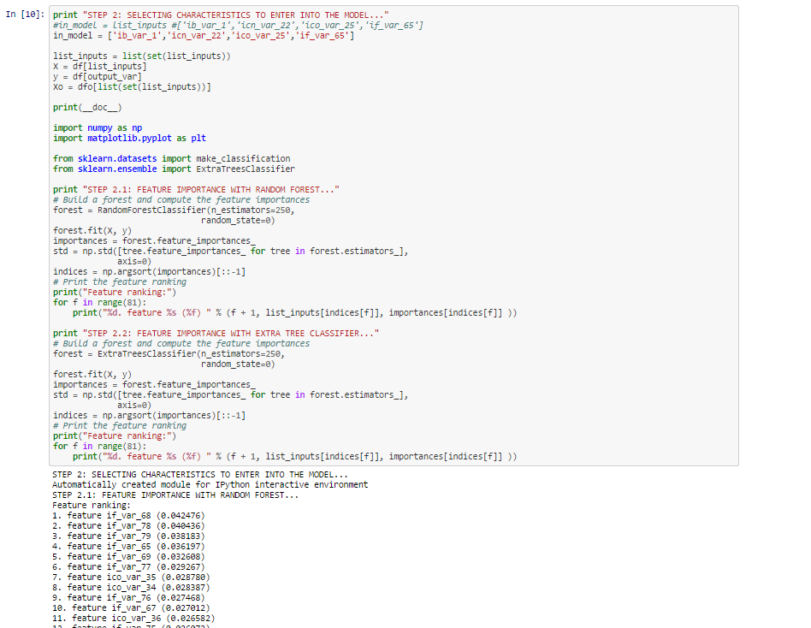
Let’s play with the code: CIFF_MBD_FA_s02.ipynb
https://dl.dropboxusercontent.com/u/28535341/CIFF_MBD_FA_s02.html

